Slide 1
MÜNSTER ENERGY DRINK
Marketing Analytics
13pm - 4.15
Julien AUFFRET B00813684
Nathan KHAYAT B00806118
Aurore MONNAIS B00754516
Olivia DE LA CHAPELLE B00811885
4.30 - 7.30pm
Hannah REVCOLEVSCHI B00805512
Charlotte CUPILLARD B00763808
Théo BELEN-HALIMI B00813297
9th of January
2024

Slide 2
Executive summary
Goal ?
What ?
How ?
Find insights on how to maximize sales of the Münster
energy drink while minimizing advertising spendings
Measure effects for channels and calculate RoI
Use a dashboard to visualize optimal allocation recommendations
Data analysis : 2 years (104 weeks) of sales with budget allocations on the 7 advertising channels
Define the exact purpose of the dashboard and test statistical and ML techniques to extract insights on correlations between variables
Steps

Slide 3
Project outline
Exploration
Strategy
Data description
Methods description
What we want to do with the data ?
What type of insights are we looking for ?
What type of dashboard do we want to build ?
What do we want to show through the dashboard ?
Data Overview
Data analysis : size, features, types, missing Values
Descriptive Statistics : mean, median, etc.
Data Distribution
Data Exploration : find patterns
Data Quality
Select 2-3 methods to modelize the data and understand interactions across channels
OLS regression model
Log/Log Specification

Slide 4
Project outline
Execution
From results
Create a dashboard
Implications and recommendations
Final product
According to the insights from dashboard, we will give several strategies for the future
To back up recommendations, use a base metric to compare results and gain non-tech teams trust:
RoI
per channel, combinations of channels and global
Analysis
Forecasts
Analysis on links found previously
Our recommendations for following week

Slide 5




KPIs & Assumptions
While brainstorming on this subject we can across many possible assumptions and KPIs. Here are some of questions we asked ourselves.
Which media are the most cost-effective? (ROI)
How sales evolve over the year. Are there any periods with major increases/decreases?
There is an optimal combination of advertising channels which, when combined, maximise reach and sales.
There exists a linear relationship between advertising spends across channels and sales.

Slide 6
Agenda
Week 1 | Week 2 | Week 3 | Week 4 | Week 4
Select project together | Data analysis by every member to get to know the project | Data analysis by every member to get to know the project | Start of the dashboard | Finish the dashboard
Gathered to establish the strategy, project outline and agenda | Data description by 3 members | Data description by 3 members | OLS and Log/Log Models and Results | Finish the slides
Assigned specific tasks to each member | Explored and selected methods to modelize the data | Method description by 3 members | Implications and Recommendations | Submit !

Slide 7







Data description - Overview
104 observations of 9 features, being the weeks (numbered from 1 to 104), the sales (sales of energy drinks for each week) and the budget allocation on the 7 advertising channels:
Out-of-Home Advertising: advertising experienced outside of the home (also called outdoor advertising) through posters, signs or preliminary signs for example.
Print Magazine Advertising: advertising using physical printed media to reach customers (magazine).
Point-of-Sale (Pos) Display Advertising: advertising found near, on or next to a checkout counter (point-of-sale).
Search Engine Advertising (SEA) Google: display targeted ads, generally above and to the side of search engine results pages.
Sport Sponsoring Advertising: partnership between a company (sponsor) and a sports club or event.
Local TV Advertising: advertising limited to specific markets or geographic areas used to reach local audiences.
Youtube Advertising: advertising on Youtube with numerous targeting options (age, location, yt search history …).

Slide 8
Data description - Overview & Statistics
Integer (only for Week) and numeric data with no missing values and only consistent ones
Outliers in the extreme values for Sales
Left Skewed
Gaussian Like Distribution
Week
Min. : 1.00
1st Qu.: 26.75
Median : 52.50
Mean : 52.50
3rd Qu.: 78.25
Max. :104.00
Sales
Min. :5.223e+08
1st Qu.:1.343e+09
Median :1.830e+09
Mean :2.414e+09
3rd Qu.:2.916e+09
Max. :7.571e+09
OutofHome
Min. : 981
1st Qu.:3204
Median :3923
Mean :4267
3rd Qu.:5155
Max. :8323
SportSponsoring
Min. : 30295
1st Qu.:128670
Median :154126
Mean :163541
3rd Qu.:198156
Max. :335875
TVAdsLocal
Min. : 13044
1st Qu.: 54050
Median : 68555
Mean : 68659
3rd Qu.: 82444
Max. :141094
SEAGoogle
Min. : 6240
1st Qu.: 7170
Median : 8516
Mean : 8453
3rd Qu.: 9292
Max. :13313
PrintMagazine
Min. : 81214
1st Qu.: 99232
Median :113884
Mean :115349
3rd Qu.:131406
Max. :158749
PosDisplay
Min. : 1090
1st Qu.: 9098
Median :16814
Mean :19506
3rd Qu.:27708
Max. :53970
Youtube
Min. :1193
1st Qu.:2869
Median :3372
Mean :3324
3rd Qu.:3746
Max. :4864

Slide 9
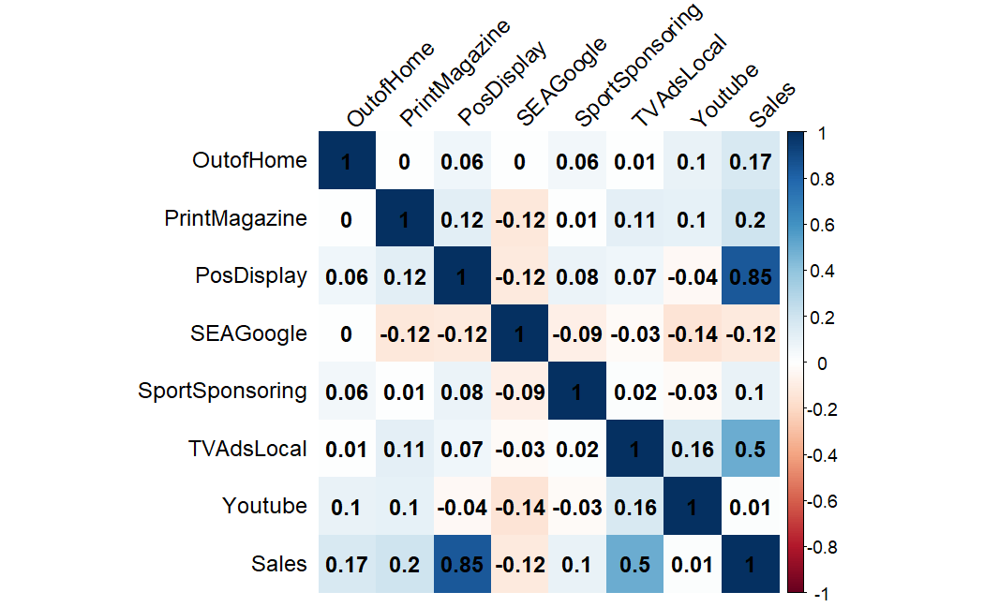
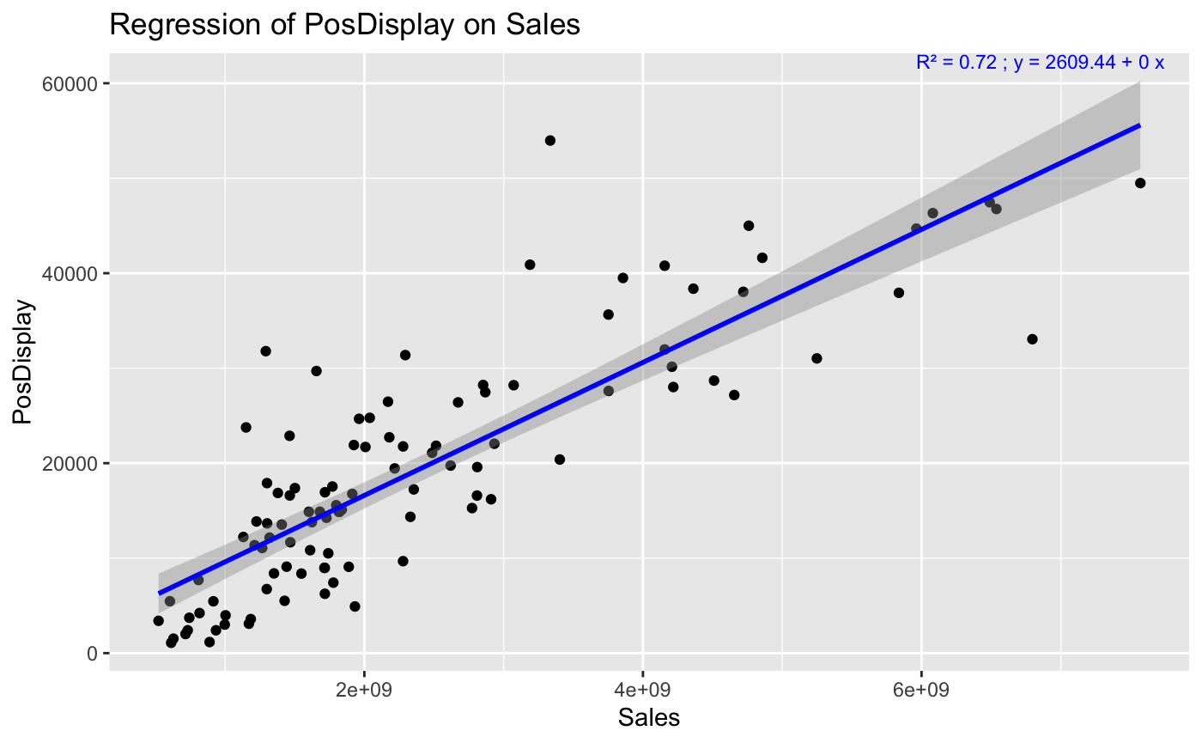
Data description - Correlation
Pearson Correlation
Regression of PosDisplay on Sales
Sales and PosDisplay seems to be very well correlated (Pearson Coefficient more than 0.7).
Sales and TVAdsLocal seems to be correlated (Pearson Coefficient around 0.5).

Slide 10
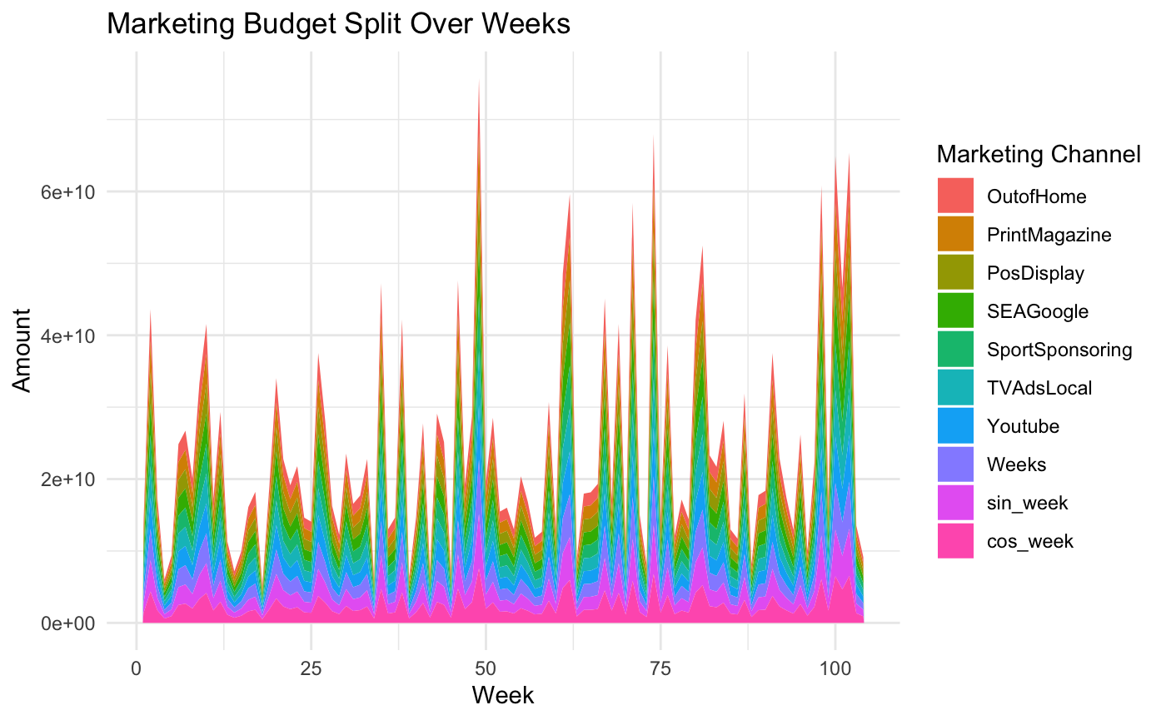
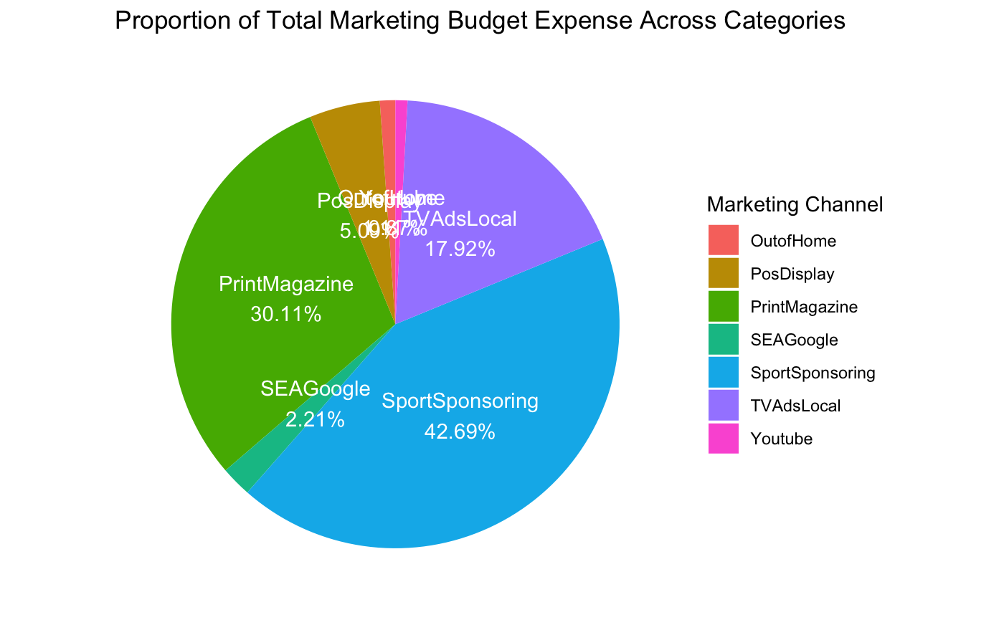
Data description - Budget Allocation
We can see that the top 3 Advertising Marketing Budget are allocated to: Print Magazine, Sport Sponsoring, and TVAdsLocal.
Are these 3 marketing budget contributing the most to the Sales ? What are their RoI ?

Slide 11
Methods description - OLS Regression Model
Definition: OLS (ordinary least squares) regression is a technique for estimating the coefficients of a linear regression describing the relationships between one or more quantitative variables and a dependent variable (depending on whether the linear regression is single or multiple). Least squares refers to the minimum squared error between the real values and the predicted ones.
Hypothesis:
Individuals (or observations) are independent.
The variance is homogeneous.
The residuals follow a normal distribution.
Method:
Import the library caTools
Read the data
Use str() function to display the compact structure of our data and its variables
Use head() function to display the first rows of our data
Use summary() function to understand the various statistical features of our labels
First step of building the linear model: initiate the set.seed() function (with the value 125 for example)
Second step of building the linear model: divide the data into training data (75%) and test data (25%)
Third step of building the linear model: implement the linear modeling model (model <- lm(y ~ x, data))
Use summary() function to display the summary of the model

Slide 12
Methods description - Log/Log Specification
Definition: the Log/Log Specification is a type of multiplicative regression analysis that converts the original data into a series of multiplicative terms expressed on a logarithmic scale. Both target variable and independent variables are subjected to logarithmic transformation. This allows for better results when dealing with data featuring non-linear relationships between input and output variables.
Method:
Import the library caTools
Read the data
Use str() function to display the compact structure of our data and its variables
Use head() function to display the first rows of our data
Use summary() function to understand the various statistical features of our labels
First step of building the regression model: initiate the different variables we will use
Second step of building the regression model: apply a logarithmic transformation to all the variables
Third step of building the regression model: build the lag traffic variable on the target variable
Fourth step of building the regression model: fit a regression using the function option() and the argument scipen
Fifth step of building the regression model: implement the log/log model (regression <- lm(lny ~ lnx))
Use summary() function to display the summary of the model

Slide 13
Results - OLS Regression Model
Call:
lm(formula = Sales ~ OutofHome + PrintMagazine + PosDisplay + SEAGoogle + SportSponsoring + TVAdsLocal + Youtube)
Residuals:
Min 1Q Median 3Q Max
-1521742498 -146455009 8178077 136950001 1544431306
Coefficients:
Estimate Std. Error t value Pr(>|t|)
(Intercept) -2099754683.4 462987886.2 -4.535 0.0000166 ***
OutofHome 123291.6 28433.7 4.336 0.0000358 ***
PrintMagazine 4150.3 2039.1 2.035 0.0446 *
PosDisplay 96798.9 3308.5 29.258 < 0.0000000000000002 ***
SEAGoogle -9053.7 29772.9 -0.304 0.7617
SportSponsoring 345.5 703.7 0.491 0.6246
TVAdsLocal 28933.8 1774.6 16.304 < 0.0000000000000002 ***
Youtube -104040.7 62622.2 -1.661 0.0999 .
---
Signif. codes: 0 ‘***’ 0.001 ‘**’ 0.01 ‘*’ 0.05 ‘.’ 0.1 ‘ ’ 1
Residual standard error: 423600000 on 96 degrees of freedom
Multiple R-squared: 0.9315, Adjusted R-squared: 0.9265
F-statistic: 186.4 on 7 and 96 DF, p-value: < 0.00000000000000022
Sales = - 2099754683.4 + 123291.6 OutOfHome + 4150.3 PrintMagazine + 96798.9 PosDisplay - 9053.7 SEAGoogle + 345.5 SportSponsoring + 28933.8 TVAdsLocal - 104040.7 Youtube + ε
The p-values of Print Magazine, SEA Google, Sport Sponsoring, and Youtube are not significant (above 0.01). The R-squared is significant. The coefficient are also very high.
Can we mitigate this by using a log/log Regression Model ?

Slide 14
Results - Log/Log Model
Call:
lm(formula = lnSales ~ L1.lnSales + lnOutofHome + lnPrintMagazine + lnPosDisplay + lnSEAGoogle + lnSportSponsoring + lnTVAdsLocal + lnYoutube)
Residuals:
Min 1Q Median 3Q Max
-0.20340 -0.10255 -0.04118 0.06055 1.06057
Coefficients:
Estimate Std. Error t value Pr(>|t|)
(Intercept) 3.001093 2.103115 1.427 0.157
L1.lnSales -0.021258 0.029955 -0.710 0.480
lnOutofHome 0.320783 0.047445 6.761 0.00000000114 ***
lnPrintMagazine 0.441342 0.095522 4.620 0.00001216622 ***
lnPosDisplay 0.567471 0.019752 28.729 < 0.0000000000000002 ***
lnSEAGoogle -0.099132 0.104878 -0.945 0.347
lnSportSponsoring -0.013340 0.043311 -0.308 0.759
lnTVAdsLocal 0.603481 0.042189 14.304 < 0.0000000000000002 ***
lnYoutube 0.001761 0.079956 0.022 0.982
---
Signif. codes: 0 ‘***’ 0.001 ‘**’ 0.01 ‘*’ 0.05 ‘.’ 0.1 ‘ ’ 1
Residual standard error: 0.1721 on 94 degrees of freedom
(1 observation deleted due to missingness)
Multiple R-squared: 0.9268, Adjusted R-squared: 0.9206
F-statistic: 148.8 on 8 and 94 DF, p-value: < 0.00000000000000022
ln(Sales) = 3.001 - 0.021258 ln(Sales_{t-1}) + 0.320783 ln(OutOfHome_t) + 0.441342 ln(PrintMagazine_t) + 0.567471 ln(PosDisplay_t) -0.099132 ln(SEAGoogle_t) -0.013340 ln(SportSponsoring_t) + 0.603481 ln(TVAdsLocal_t) + 0.001761 ln(Youtube_t) + ε_t
Some variables’ p-values are still not significant (above 0.05), but Print Magazine is now significant. The R-squared is still significant.
Can we improve the current model by keeping only the significant variables ?

Slide 15
Results - Log/Log Model
Call:
lm(formula = lnSales ~ lnOutofHome + lnPrintMagazine + lnPosDisplay + lnTVAdsLocal)
Residuals:
Min 1Q Median 3Q Max
-0.18232 -0.10625 -0.05427 0.05837 1.07470
Coefficients:
Estimate Std. Error t value Pr(>|t|)
(Intercept) 1.25359 1.18091 1.062 0.291
lnOutofHome 0.31916 0.04544 7.024 0.000000000276 ***
lnPrintMagazine 0.45757 0.09252 4.945 0.000003107675 ***
lnPosDisplay 0.56768 0.01913 29.676 < 0.0000000000000002 ***
lnTVAdsLocal 0.61011 0.04089 14.922 < 0.0000000000000002 ***
---
Signif. codes: 0 ‘***’ 0.001 ‘**’ 0.01 ‘*’ 0.05 ‘.’ 0.1 ‘ ’ 1
Residual standard error: 0.1694 on 99 degrees of freedom
Multiple R-squared: 0.9256, Adjusted R-squared: 0.9226
F-statistic: 307.8 on 4 and 99 DF, p-value: < 0.00000000000000022
All the variables are significant as their respective p-values are very small.
The R-squared have been improved compared to the previous regression model.
Are the marketing channels SEA Google, Sport Sponsoring and Youtube really contributing to the Sales of Münster Energy Drinks ?
In other words, should we invest in these channels ?
ln(Sales) = 1.25359 + 0.31916 ln(OutOfHome_t) + 0.45757 ln(PrintMagazine_t) + 0.56768 ln(PosDisplay_t) + 0.61011 ln(TVAdsLocal_t) + ε_t

Slide 16
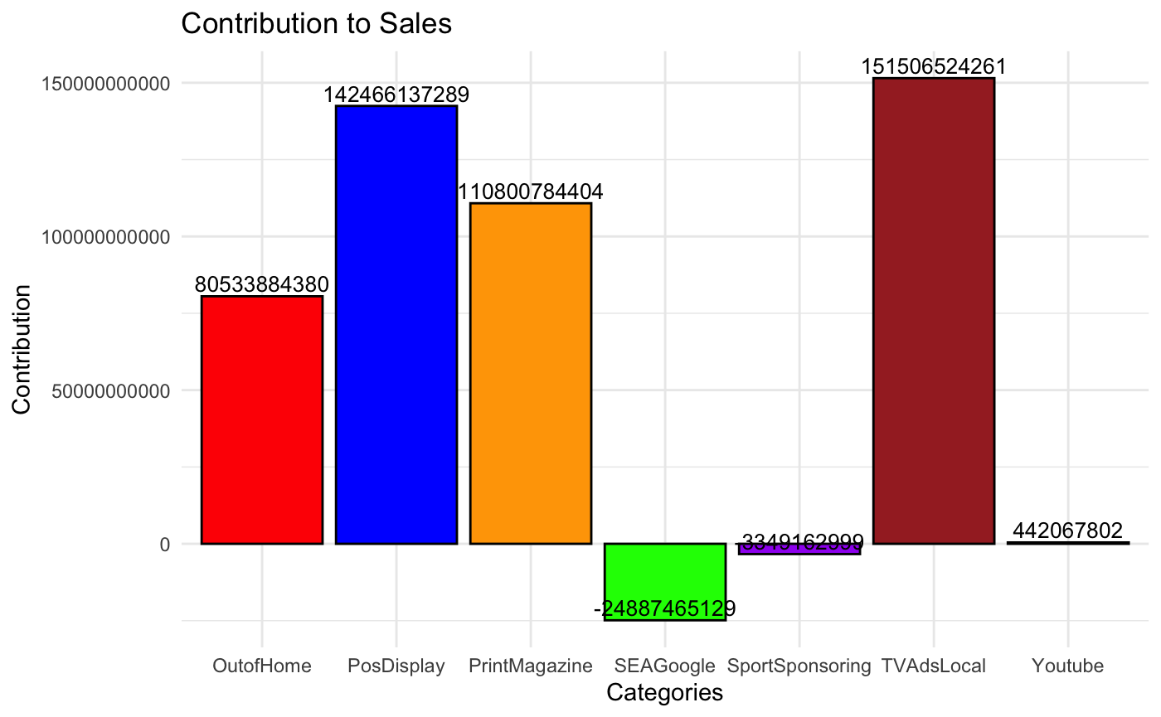
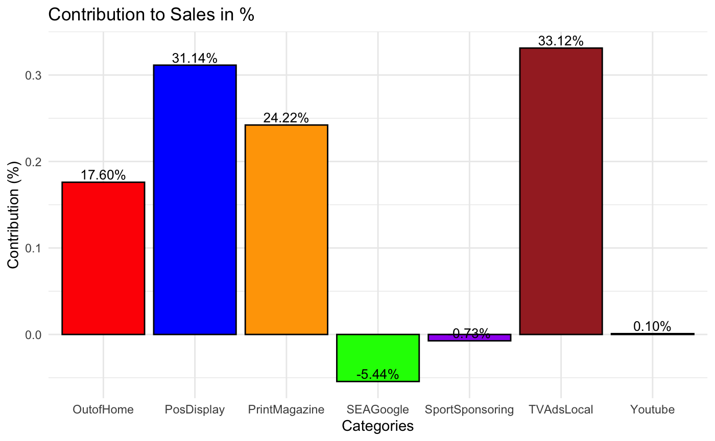
Results - Channels Contribution
channel’ s contribution to sales = beta_channel * (average_sales / average_channel) * sum_channel
Out of Home, Pos Display, Print Magazine and TV Ads Local Advertising are the ones contributing the most to Sales.
SEA Google and Sport Sponsoring Advertising are contributing negatively to Sales.
Youtube Advertising is poorly contributing to Sales.

Slide 17
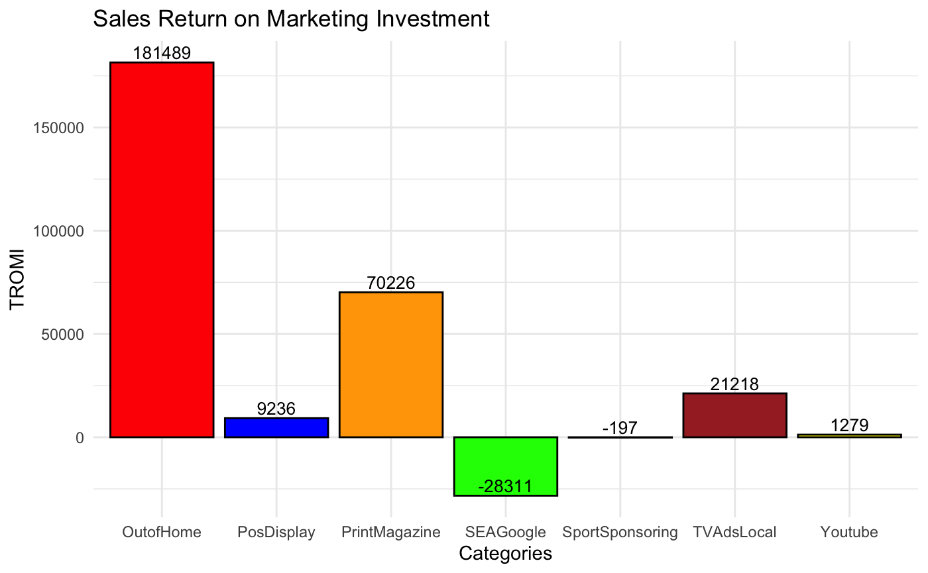
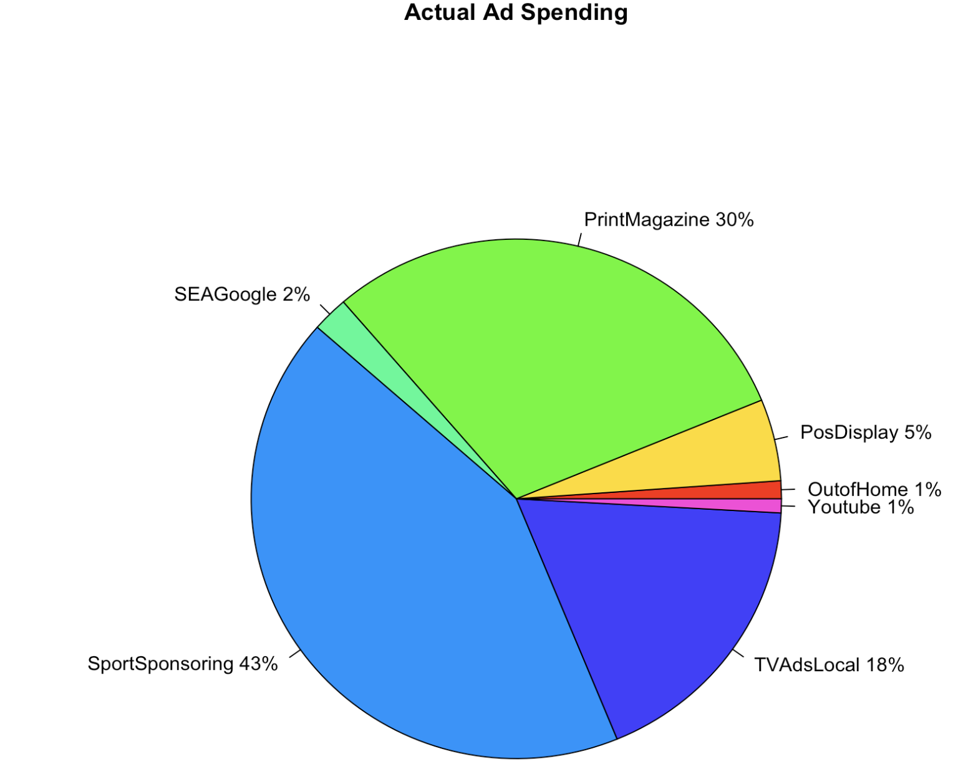
Results - Channels RoI
channel’ s RoI = channel’s contribution / channel’s cost
Sales Return on Marketing Investment
The best RoI is for the Out of Home Advertising as it is one of the channel contributing the most to the Sales and it has the lowest marketing spending.
Print Magazine and TV Local Advertising are following and have great positive RoI and a good part of Marketing Advertising Spendings.
Pos Display Advertising has the second best contribution to Sales but only 5% of the budget, which explain why its RoI is positive but not as high as the previous channels.
Youtube Advertising contribution and costs are aligned, which explain the actual RoI.
Sport Sponsoring Advertising has a negative RoI, with around 43% of the overall spending contributed to this channel, for a negative contribution to Sales.
Google SEA has the worst RoI, with only 2% of the overall spending and the worst contribution to Sales.
Actual Advertising Spending
Total RoI: 11483.09

Slide 18
Implications & Recommendations
Channels performing well
Channel performing in adequation to its budget
Channel performing badly with low budget
Channel performing badly with high budget
Out-of-Home Advertising
Magazine Advertising
Pos Display Advertising
TV Local Advertising
Youtube Advertising
Google SEA
Sport Sponsoring Advertising
Channels performing well should be kept but maybe with a different budget allocation.
A channel performing in adequation to its budget could have a better budget to perform better or not be kept.
A channel could perform badly if it has little budget or if it's not a good communication channel for the product.
A channel performing badly with a high budget allocation could be reviewed: should it be kept or invested in more ?
Which channels should we keep, with which budget allocation, to improve our RoI ?

Slide 19
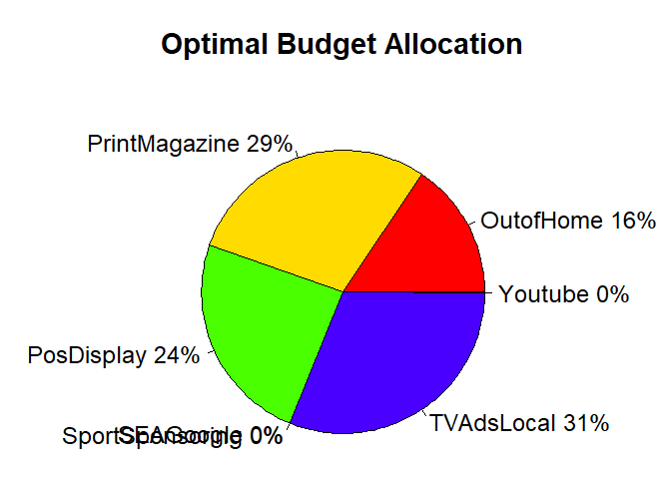
Implications & Recommendations
New allocation of the Marketing Budget to the channels that perform well (contribute the most to Sales).
Pos Display Advertising - 22% (previously 5%)
Print Magazine Advertising - 31% (previously 30%)
Out of Home Advertising - 16% (previously 1%)
TV Local Advertising - 31% (previously 18%)
Youtube Advertising - 0%
(previously 1%)
SEA Google - 0% (previously 1%)
These new budget allocations have been determined based on elasticity of a channel divided by the sum of elasticities of all the channels.
But is it really realistic regarding the brand image and its positioning ?

Slide 20
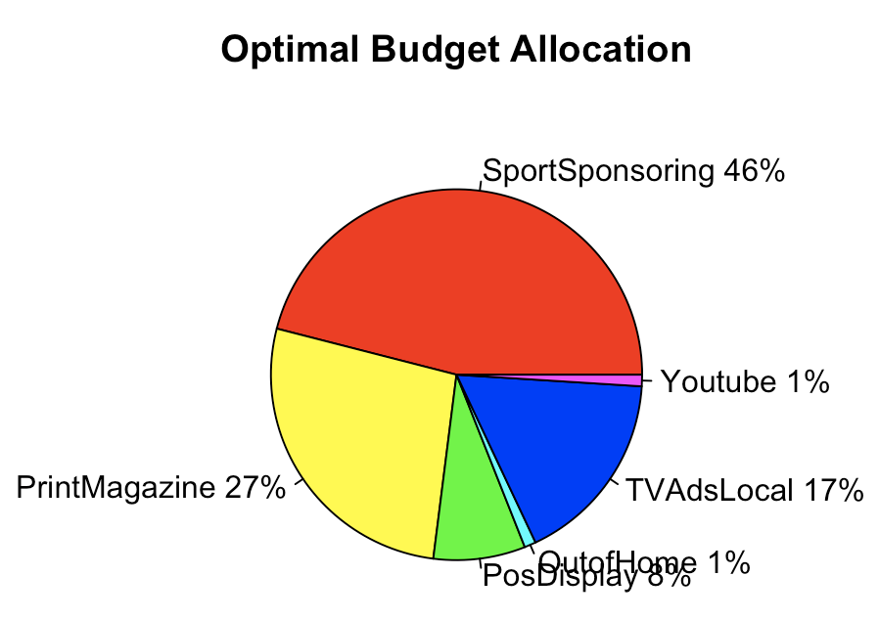
Implications & Recommendations
Münster Energy Drinks are strongly associated to the extreme sports, especially cars and moto cross activities. Not investing in this channel would be a strong positionment error from the marketing team. Therefore, the negative RoI could be reversed by investing more in this channel. The new allocation would be as followed:
Sport Sponsoring - 46% : increase the investment in this channel to have a positive RoI
Print Magazine Advertising - 27% : decrease a bit the investment in this channel with a good RoI
TV Local Advertising - 17% : decrease a bit the investment in this channel with a good RoI
Pos Display Advertising - 8% : increase the investment in this channel to have an even greater RoI
Out of Home Advertising - 1% : no need to invest more in this channel as its contribution to Sales are great without a big investment
Youtube Advertising - 1% : the performance of this channel are satisfying
SEA Google - 0%

Slide 21
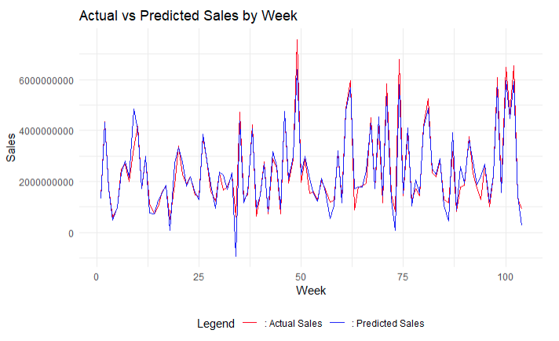
Implications & Recommendations
Sales and Budget Allocation Evolutions
After the reallocation of the budget, we obtain this graph of the actual sales and the predicted sales with the new budget.
However, we can see that the sales are the same, meaning our model has some issues, it could be in the new data or in our regression model.
Indeed, the change in budget should have changed the total number of sales.

